Slide 1
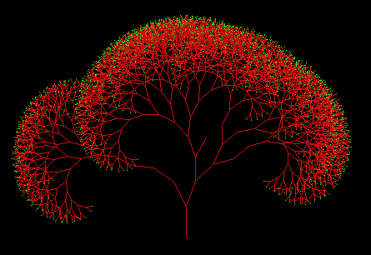
Lecture#6
Decision Trees #1

Slide 2
Objective
to learn about a classification method, called, decision tree, and its related issues.

Slide 3
Definition
: a representation in which
  each node is connected to a set of possible answers
  each nonleaf node is connected to a test that split its set of possible answers into subsets corresponding to different test results

Slide 4
  each branch carries a particular test result subset to another node
  each unique path represents the rules of variables on the path AND together

Slide 5
ROOT
branch
nonleaf node or parent node
Y
Y
N
leaf node or offspring node
Y
N

Slide 6
1.1 The ID3 approach (Iterative Dichotomizer 3 – Quinlan 1986)
General idea
  Requirement: need to use with categorical data or “label” like data
  Concept: use a greedy concept with “Information Gain” as heuristics criteria in finding the best input feature to split the tree.
  Better improvement algorithm: C4.5 (1993) by the same author

Slide 7
2. Entropy measure
: measures the impurity level of collection of examples (the lower entropy value, the better)
P₁ = ½
C₁
C₂
P₂ = ½
2
Entropy = - ∑ P_{i} log₂ P_{i}
i = 1

Slide 8
Entropy = 1.0 ; most confusing case
P₁=0.5
P₂=0.5
P₁=0.75
P₂=0.25
Entropy = 0.85
Entropy = 0.0 ; most clear case
P₁=1.0
P₂=0.0
Entropy ∈ [0, log₂n] ; n = the number of discrete values of an feature

Slide 9
3. Information gain measure
: measures the improvement of entropy value after the splitting from before splitting
Info. Gain = EnBeforeSplit - EnAfterSplit

Slide 10
1.2 Test splitting properties
Ex Given 60 people (30 females, 30 males)
x₁ = hair color (red, not_red)
x₂ = hair length (short, long)
x₃ = wearing make up (yes, no)
y = sex (female, male)
Which feature is best in dividing class (Y) into the purest grouping?

Slide 11
Test#1-- Hair color
Test#2-- Hair length
hair color
hair length
red
not_red
long
short
20 f
10 f
15 f
15 f
20 m
10 m
5 m
25 m
Entropy = 1.0
Entropy = 0.85

Slide 12
Test#3 -- Wearing make up
wearing make up
Yes
No
20 f
10 f
0 m
30 m
Entropy = 0 ; Use this feature as the root of the tree…..!!!

Slide 13
1.3 Algorithm
(a) Calculate entropy before splitting, (how n-class are distributed)
n
En _{(before)} = - ∑ P_{i} log₂ P_{i}
i = 1
Ex P(A) = ⅝ P(O) = ⅜
En _{(before)} = - ⅝ log₂ (⅝) - ⅜ log₂ (⅜)
= 0.954

Slide 14
(b) Test and calculate the entropy after splitting of each feature
Ex (i) Testing “height” feature
height
After testing “height”
W₁ = 5/8 W₂ = 3/8
En_{(after)} = W₁ ● En_{(tall)}
+ W₂ ● En_{(short)}
= 0.951
tall
short
5
3
P(A) = 3/5
P(O) = 2/5
En _{(tall)} = 0.971
P(A) = 2/3
P(O) = 1/3
En _{(short)} = 0.918

Slide 15
Ex (ii) Testing other features the same way
En_{after (hair color)} = 0.5
En_{after (eye color)} = 0.607

Slide 16
(c) Calculate Information Gain of each feature by
Info Gain_{x} = En_{before} – En_{after}
Ex Info Gain_{height} = 0.954-0.951 = 0.003
Info Gain_{hair color} = 0.954-0.5 = 0.454 **
Info Gain_{eye color} = 0.954-0.607 = 0.247

Slide 17
(d) Pick the highest Info Gain X to split the tree
Ex
hair color
dark
blond
red

Slide 18
(e) Continue step (a)...(d) recursively to the next level of the tree until the leaf is pure or no more candidate feature to work on.

Slide 19
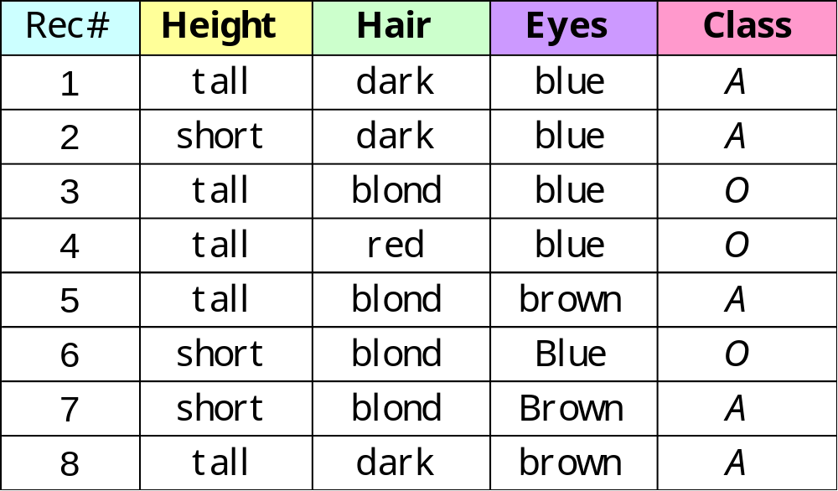
Example6.1 Classifying Individuals on the Basis of Certain Physical Characteristics

Slide 20
height
tall
short
tall, blond, brown: A tall, red, blue: O tall, dark, blue: A tall, blond, blue: O tall, dark, brown: A
short, blond, blue: O short, dark, blue: A short, blond, brown:A
Figure 6.1 Information gained by testing the “height” feature

Slide 21
hair color
dark
blond
red
short, dark, blue: A tall, dark, blue: A tall, dark, brown:A
tall,red, blue: O
short, blond, blue: O tall, blond, brown: A tall, blond, blue: O short, blond, brown:A
Figure 6.2 Information gained by testing the “hair” feature

Slide 22
eye color
blue
brown
tall, dark, blue: A short, dark, blue: A tall, blond, blue: O tall, red, blue: O short, blond, blue: O
tall, blond, brown: A
short, blond, brown: A
tall, dark, brown: A
Figure 6.3 Information gained by testing the “eyes” feature

Slide 23
hair color
blond
dark
red
short, dark, blue: A tall, dark, blue: A tall, dark, brown:A
tall,red, blue: O
eye color
blue
brown
tall, blond, blue: O short, blond, blue: O
tall, blond, brown: A short, blond, brown: A
Figure 6.4 An ID3 two-level decision tree

Slide 24
Decision Tree Evaluation:
If the accuracy of 2 trees are the same, then the smaller tree is better. ← Based on “Occam Razor’s” simplicity principle.
If the accuracy are unlikely be the same. Calculate the error rate (T) of an entire tree for each tree and make a comparison.
If T(tree1) < T(tree2) → tree1 is better.
EX. Class=A Class=O Class=A Class= O
7=A, 3=O 2=A, 3=O 7=A, 1=O 2=A, 5=O

Slide 25
References:
Breiman, L, Friedman, J., H., Olshen, R., A., & Stone, P., J., “Classification and regression trees”, Wadsworth International Group, 1984.
Mitchell, T., “Machine Learning”, McGraw-Hill, 1997.
Quinlan, J. R., “C4.5 Programs for Machine Learning”, Morgan Kaufmann, 1993.

